Slide 1
IoT Based Smart Sniper

Slide 2
AGENDA
Problem definition
Objectives
What exactly Smart Sniper is ???
Present theories and solutions
Block diagram
Methodology
hardware used
Software used
Results and discussions
Future scope
Conclusion
References

Slide 3
PROBLEM DEFINITION
Real-time surveillance is an integral component in any situation or environment where there is a high need of security for both personal and commercial property.
The Indian defense system needs instant enemy detection and tracking. In today’s day to day life we can use technology in many different ways to provide such surveillance .
Here we look forward for the automatic sniper, which can be the solution for this.

Slide 4
OBJECTIVES
To improve our defense system from traditional or manual to smart.
To save the manpower.
To improve secure defense system.
To develop a cost effective solution for controlling and monitoring critical situations on field.

Slide 5
WHAT EXACTLY SMART SNIPER IS ???
As per the name suggest, initially we detect the stationary targets and gun will be controlled by the operator to locate the actual target. Sniper will move in Upward, Downward, right and left direction according to the requirement.
For detection we use webcam on sniper that shows actual on field video streaming on monitor at control unit. This advanced feature we have used in our system for providing reliability to operator while operating.

Slide 6
PRESENT THEORIES AND SOLUTIONS
A Real-time Surveillance Mini-rover Based on open CV-Python-JAVA Using Raspberry Pi 2.
Low Cost Real-Time System Monitoring using Raspberry Pi.
Optical target locator developed by Laser Science and Technology Center(LASTEC).
Target detecting defense humanoid sniper.
Computer controlled USB BB sniper with video camera scope sight.

Slide 7
BLOCK DIAGRAM

Slide 8
METHODOLOGY
Detection and Firing unit (DFU)
Control unit (Deadly eye)

Slide 9
HARDWARE USED

Slide 10
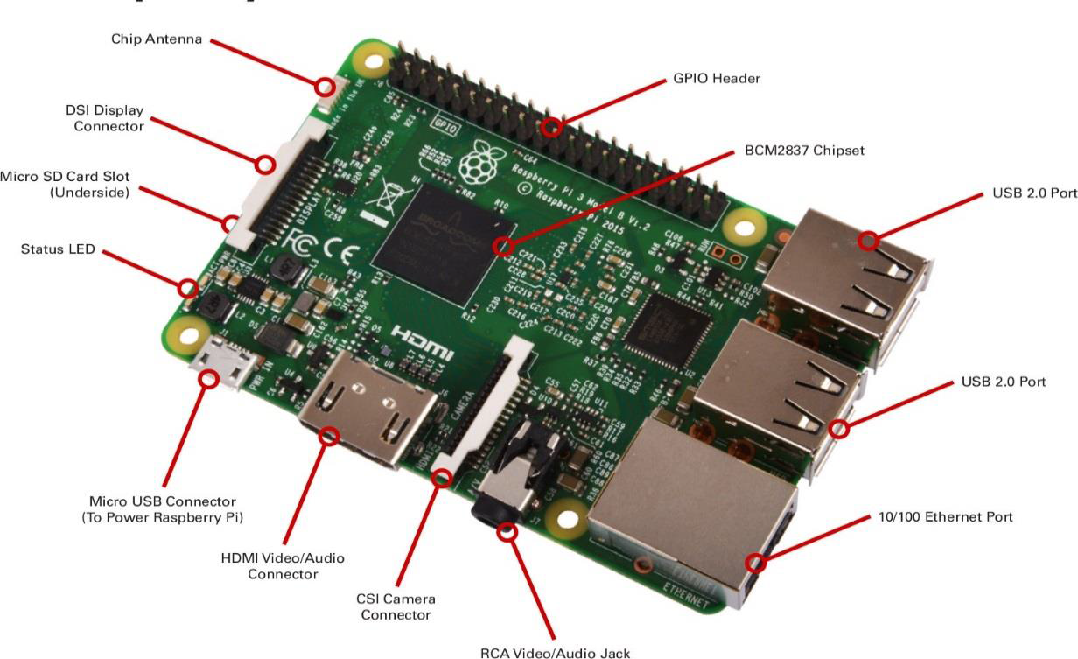
RASPBERRY PI-3
A 1.2GHz 64-bit quad-core ARMv8 CPU
802.11n Wireless LAN
Bluetooth 4.1
1GB RAM
4 USB ports
40 GPIO pins
Full HDMI and Ethernet port
Combined 3.5mm audio jack and composite
video

Slide 11
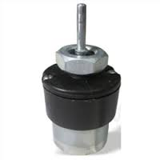
DC MOTOR
Parameter | 45 rpm | 10 rpm | 3.5 rpm
torque | 2 kgcm | 10 kgcm | 12 kgcm
weight | 125 gms | 125 gms | 125 gms
No-load current | 60 mA (Max) | 60 mA (Max) | 60 mA (Max)
Load current | 300 mA (Max) | 300 mA (Max) | 300 mA (Max)
shaft diameter | 4 mm | 6 mm | 6 mm

Slide 12
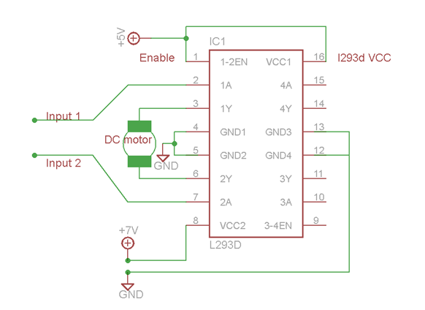
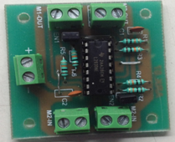
MOTOR DRIVER

Slide 13
USB WEBCAM
Image Sensor High Quality CMOS Sensor
Image Resolution 5 Mega Pixels (Interpolated) 8 white lights
Anti-flicker 50Hz,60Hz or outdoor
Image Quality: RGB24 or I420
Interface: USB2.0
Frame Rate: 30 fps (MAX)
Lens : f=6.0 F=2.0
Focus Range 4cm to infinity

Slide 14
SPUR GEAR

Slide 15
CYLINDRICAL CAM OR BARREL CAM

Slide 16
SOFTWARE USED

Slide 17
PuTTY
interface between user and Raspberry Pi-3 module.
free and open source terminal emulator
serial console
network file transfer application
supports network protocols SCP , SSH, Telnet

Slide 18
RASPBIAN OS
Raspbian is a free operating system based on Debian optimized for the Raspberry Pi hardware.
It is a version of Linux built specifically for the Raspberry Pi.
It has LibreOffice as an office suite, a web browser, email program, and some tools to teach programming.
Raspbian provides more than a pure OS, it comes with over 35,000 packages, pre-compiled software bundled in a nice format for easy installation on Raspberry Pi.

Slide 19
RESULTS AND DISCUSSION

Slide 20
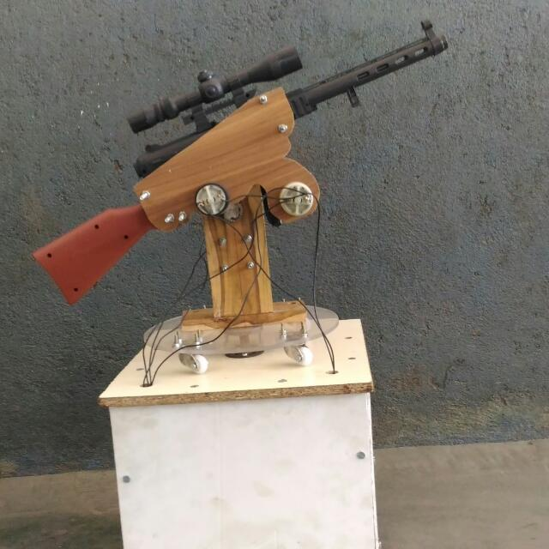
ACTUAL IMPLEMENTATION

Slide 21
ADVANTAGES
Less Cost.
Less power required.
Saves man power.
Provides security and safety.
APPLICATIONS
Military applications.
For security purpose in crowded areas.
Research and development.

Slide 22
APPROXIMATE COST
Sr. No. | Component | Cost (RS)
1. | Raspberry Pi-3 module | 3500
2. | USB webcam | 1500
3. | Dc motors | 1500
4. | Motor driver | 700
5. | Sniper | 500
6. | Miscellaneous | 500
7. | Total | 8200

Slide 23
FUTURE SCOPE
We can implement such sniper on quad copter.
Target detection using facial biometrics.
Automatic face verification using Elastic Graph matching (EGM).
Electromagnetic triggering mechanism .

Slide 24
CONCLUSION
We all know that traditionally, soldiers have to operate their guns/riffles/snipers at the risk of their lives to protect the country’s borders. But there we observe the disadvantages of this conventional method.
The proposed system helps to control the snipers remotely from the safe places, from where soldiers can detect enemies and fire if any danger is anticipated. The system can be used in remote areas at the war fields or line of control. The system uses Wi-Fi for the communication between sniper and base station

Slide 25
REFERENCES
CSI Communications-Knowledge digest for IT community.
DRDO newsletter - Published by Director,DESIDOC,Metcaffe house,Delhi-110 054 .
Shajahan.J.A ,”Target detecting defense humanoid sniper Third” international conference on computing communication & networking(ICCCNT)-2012.
4. Computer controlled USB BB sniper with video camera scope sight, tested
at US Army.

Slide 26
Thank you…

